Slide 1

Crime Statistics Northern Ireland
Albert Shuvo Gomes
Q15995259

Slide 2
Content
Analysis Objectives
Trend in crime followed by each year.
City peaked in crime occurrence, according to the police record.
Type of crime exceeded in the police record.
Grouping of City data.
Grouping of Crime type data.
Data Collection
Data has been retrieved from one source or website: data.world 2020. “Police recorded crime in the parts of Northern Ireland”.
Data Preparation
Data restructure
Data extraction
Descriptive Analytics – Correlation Analysis and Clustering Analysis.
Predictive Analytics – Time series analysis

Slide 3
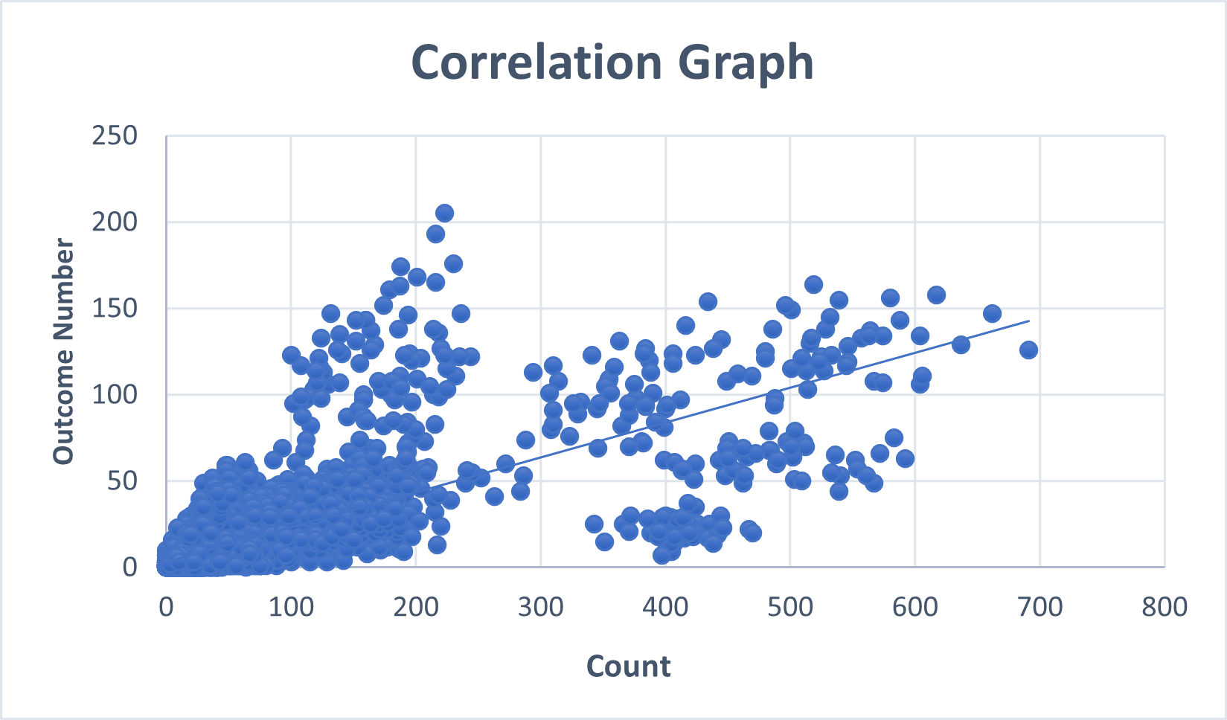
Descriptive Analytics
Correlation coefficient = 0.96218
Positive linear correlation

Slide 4
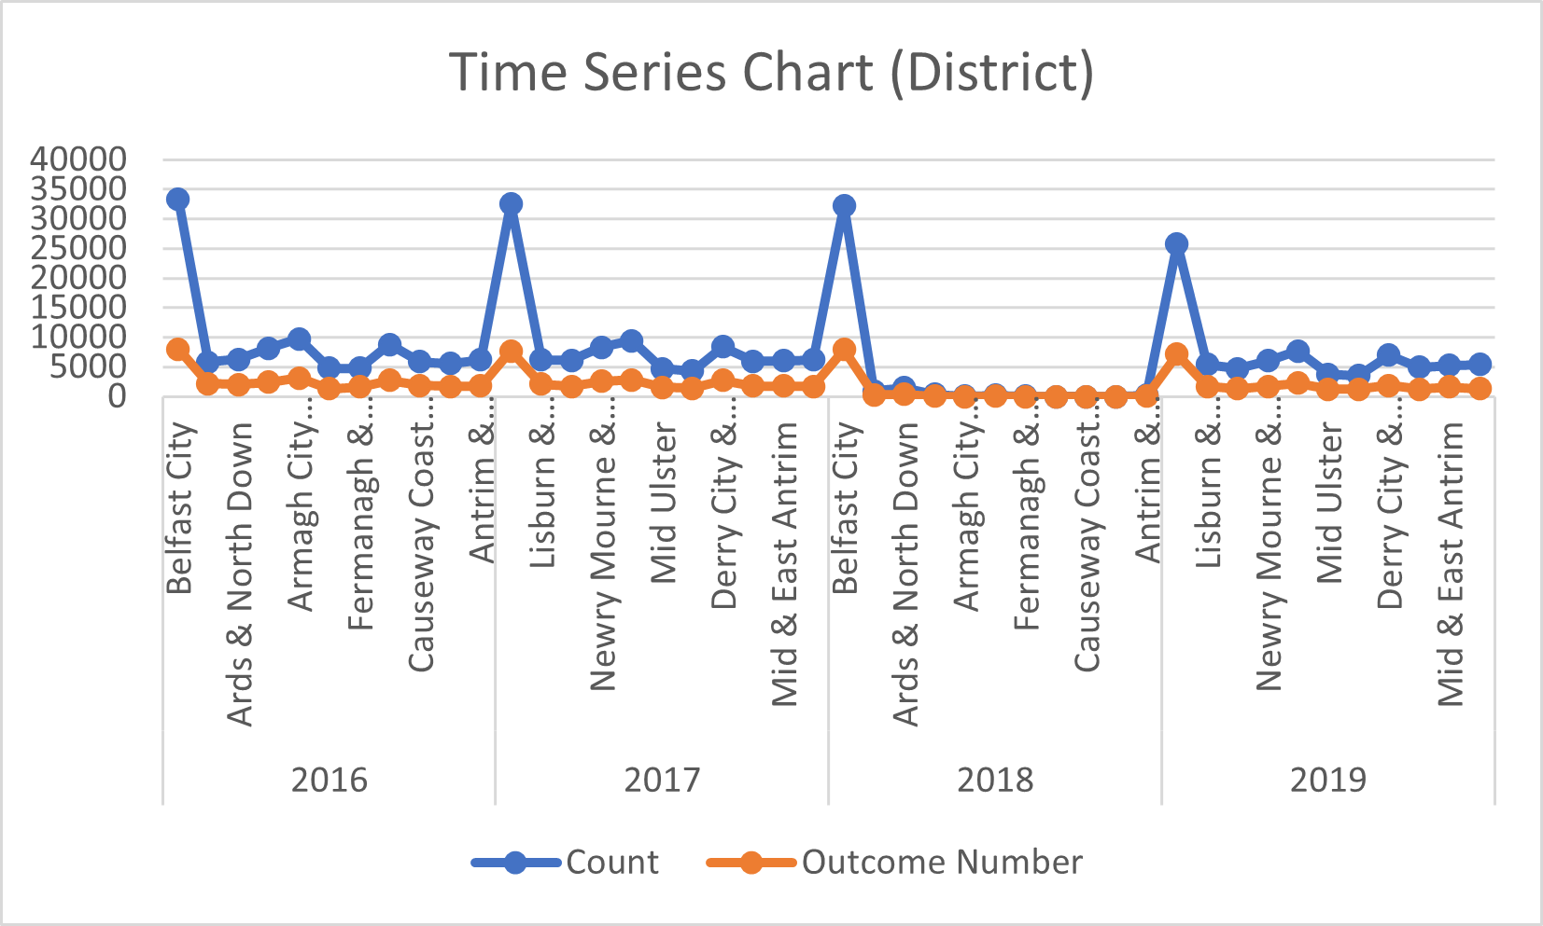
Predictive Analytics
Belfast City significantly higher in crime rate
Outcome comparative less
Similar trend in four consecutive years

Slide 5
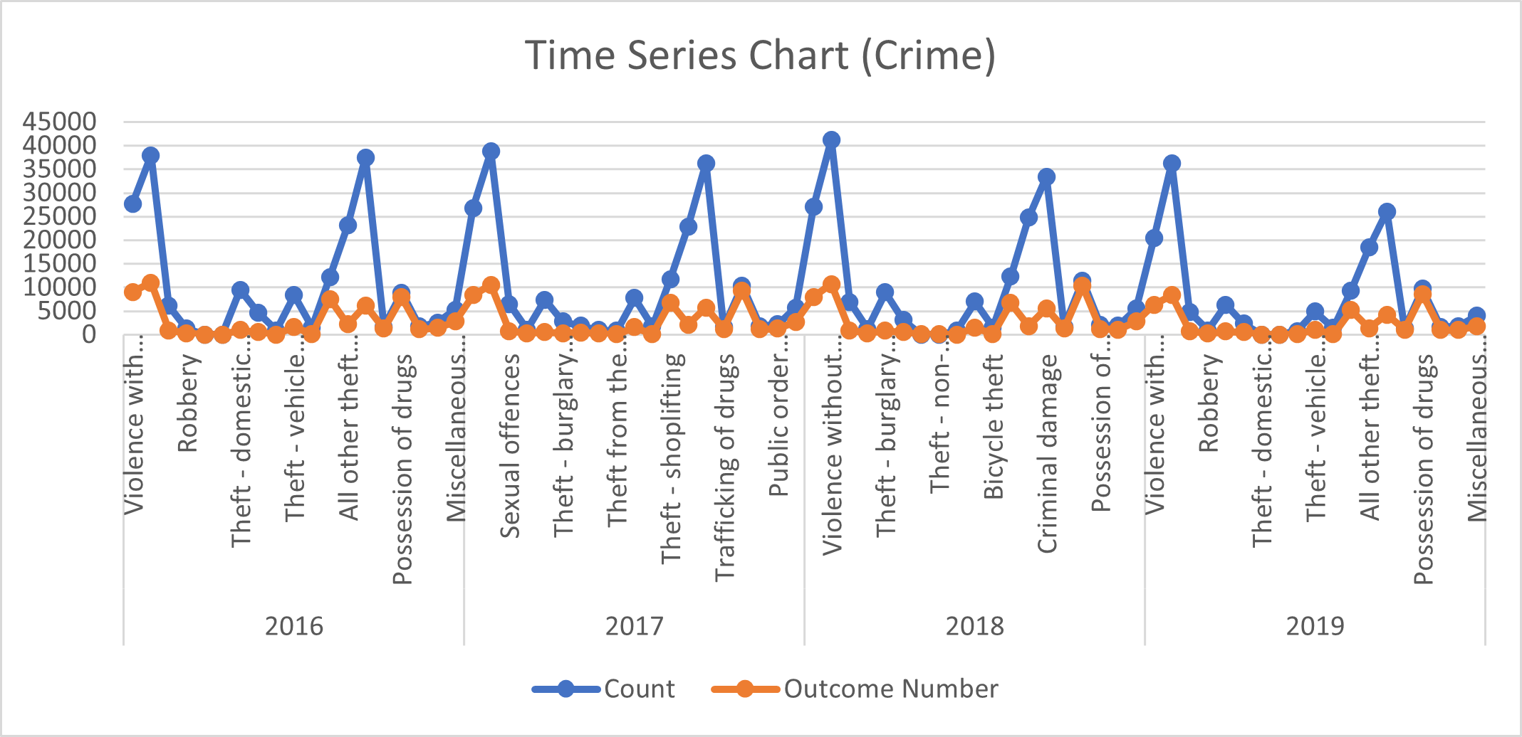
Predictive Analytics
Violence without injury (including harassment), significantly higher
Theft domestic burglary

Slide 6
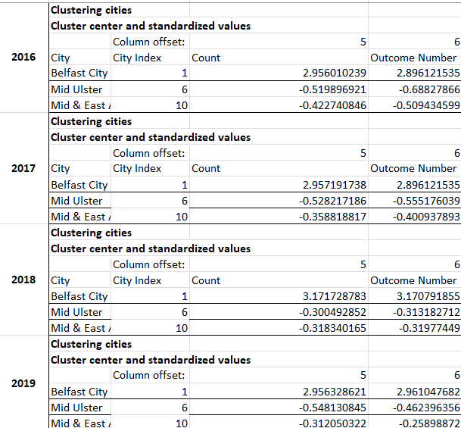
Descriptive Analytics
Clustering analysis
Standardized values
Three random city chosen as center

Slide 7
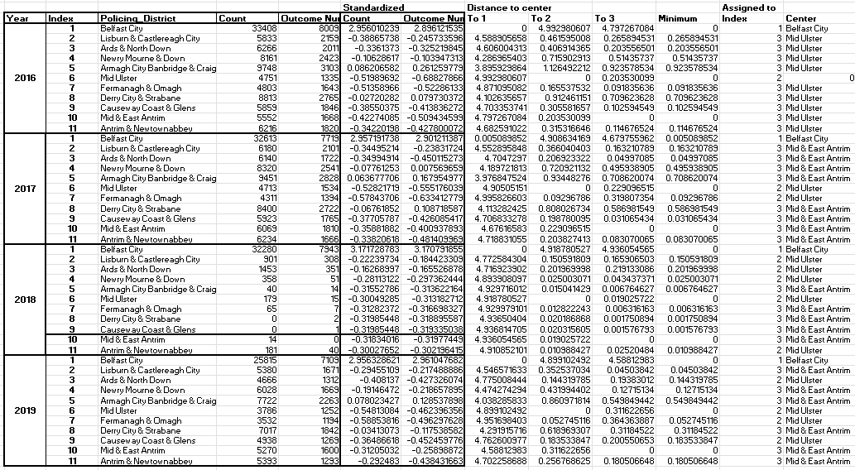
Clustering analysis based on city centroids

Slide 8
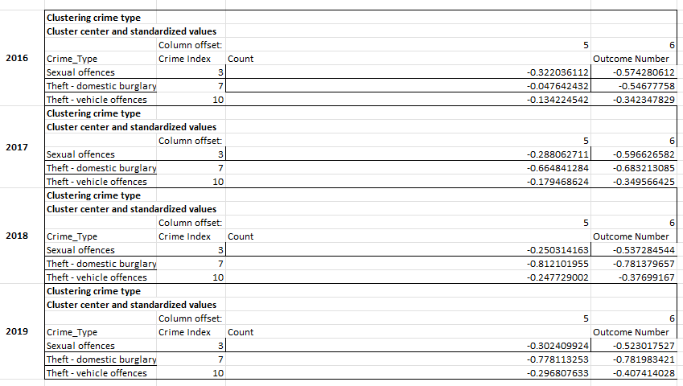
Descriptive Analytics
Clustering analysis
Standardized values
Three randomly chosen values

Slide 9
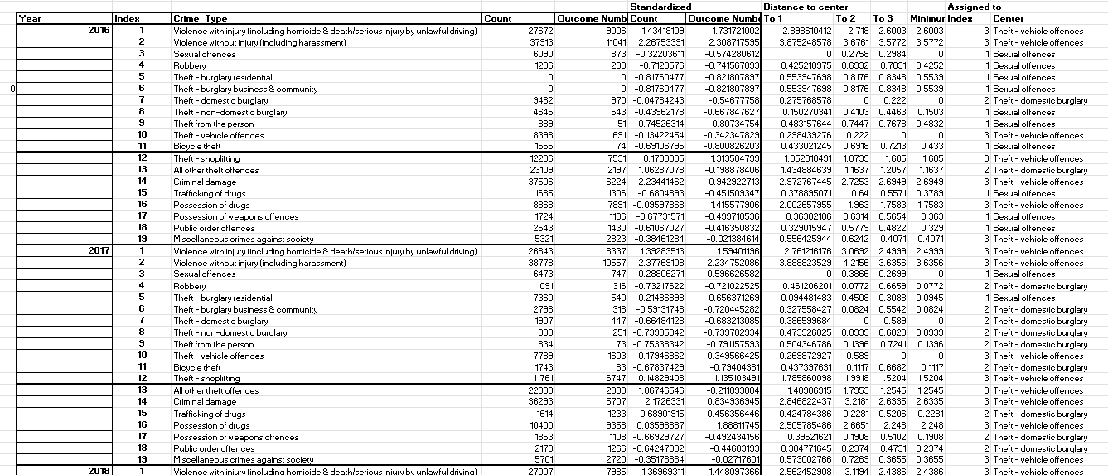
Clustering analysis based on crime type

Slide 10
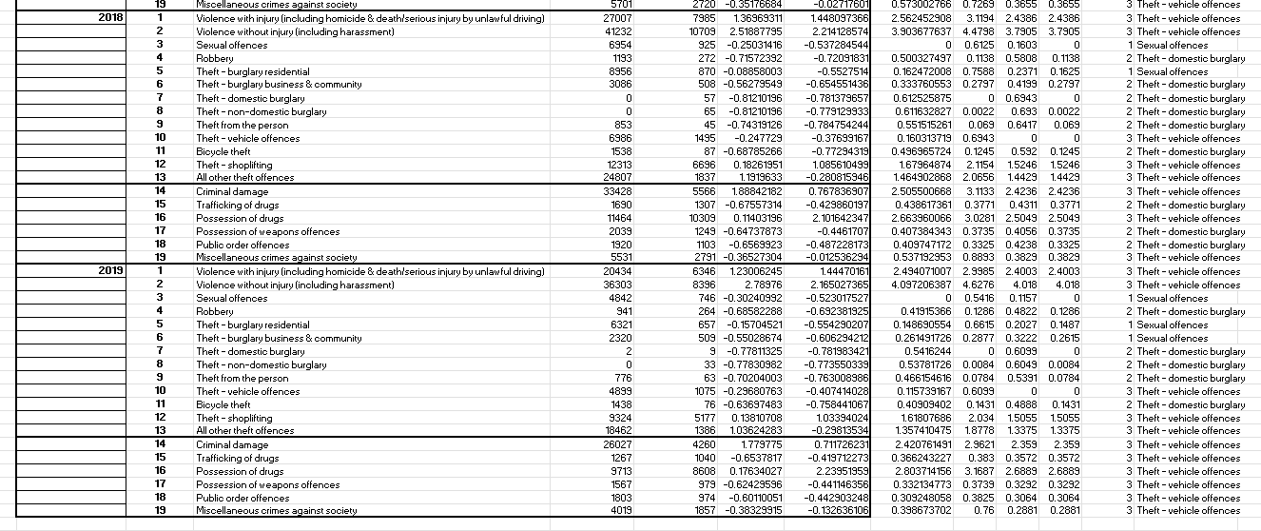

Slide 11

Thank You!

